Slide 1
Unsupervised Learning: Further on Hebbian Learning & PCA
CSE301 Bio-computation, Week 10, 2016
Bailing Zhang

Slide 2
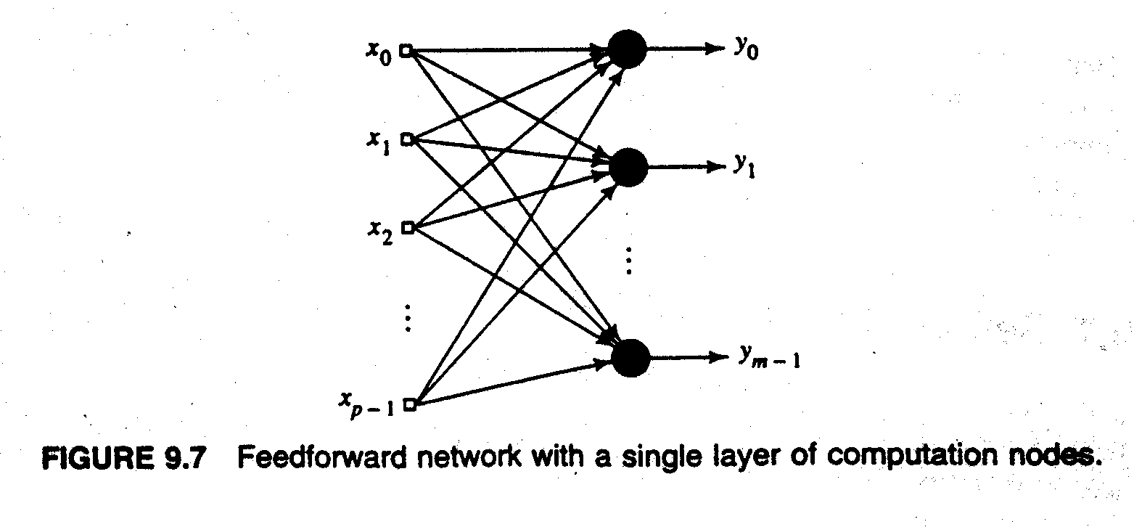
Hebbian Network for PCA
Oja’s rule will give us the first eigenvector for a small enough step-size
Question: how to extract multiple Principal Components
?
ΔW(t) = η [x(t) - W(t) y(t)] y(t)^{T}
duplication/redundancy!

Slide 3
Hebbian Network for PCA
How to find the projection onto orthogonal direction?
Deflation method: subtract the principal component from the input
Assume that the first component is already obtained; then
the output value can be ``deflated'' by the following transformation:
x = (I- w₁ w^{T}₁) x
Deflation is similar to Gram-Schmidt procedure!

Slide 4
Oja’s rule can be extended to extract multiple principal components
Deflation procedure is adopted to compute the other eigenvectors.
Step 1: Find the first principal component using Oja’s rule
Step 2: Compute the projection of the first eigenvector on the input
Step 3: Generate the modified input as
Step 4: Repeat Oja’s rule on the modified data
The steps can be repeated to generate all the eigenvectors.

Slide 5
Sanger’s Rule - GHA
Sanger’s rule, Generalized Hebbian Algorithm (GHA), is a modification of Oja’s rule that implements the deflation method for PCA
Classical PCA involves matrix operations
Sanger’s rule implements PCA in an iterative fashion for neural networks
Consider p inputs and m outputs, where m < p
and, the update (Sanger’s rule)

Slide 6
Further explanation of Sanger’s Rule
or
For k = 1, it is the same as Oja’s rule. For k = 2, we have
When convergence is reached, all w vectors are orthogonal
to each other and normalized to 1. w_{j} is then an eigenvector
of R with eigenvalue λ_{j.} The eigenvalues are in decreasing
order with index j.

Slide 7
Further Explanation of Sanger’s Rule (GHA)
The set of values y_{j} = x^{T} w_{j} are called principal components of x. The set of directions w are the principal directions in the sample space x for the variance y.
The variance y forms a high dimensional "ellipsoid": (assume E(y)=0)
the direction w₁ corresponds to the direction of largest variation λ₁; w₂ gives the second largest variance in a direction that is perpendicular to w₁ , w₃ is third largest variation direction that is perpendicular to w₁ and w₂ , and so on.

Slide 8
Summary of GHA Procedure
Oja’s rule + Deflation = Sanger’s rule
Subtract the contribution of the 1st principal component
Drive the difference into another Hebbian neuron
This extracts the next principal component
Subtract its contribution. Go to Step 2
With N Hebbian neurons, we’ll get all N principal components
Ref: Sanger, Terence D. (1989). "Optimal unsupervised learning in a single-layer linear feedforward neural network". Neural Networks 2 (6): 459–473.

Slide 9
function [W, errvals]=gha(X, k, varargin)
% GHA Generalized Hebbian Algorithm for PCA
%
% [W, errvals] = gha(X, k, options)
% X is the set of input vectors. Each column of X is one sample.
% k is the number of principal components to extract.
% W is the matrix of principal components.
% errvals is an approximation of the error at every iteration
%
% options (specified by key/value pairs)
% 'rate' = 0.1 the learning rate
% 'W' = randn the initial component matrix
% 'niter' = 1 the number of iterations
% 'annealfunc' = 1 the annealing function, the current iteration
% 'printerr' = 0 boolean value to print the error
% get the dimensionality
[m n] = size(X);

Slide 10
% random initial weights
W = 0.1*randn(m,k);
options = struct(...
'rate', .1, ...
'W', W, ...
'niter', 1, ...
'annealfunc', inline('1'), ...
'printerr', 0);
options = getopt(options, varargin);
% validate options
if (size(options.W,1)~= size(W,1) && size(options.W, 2)~=size(W,2))
warning('Invalid initial set of weights, using random.');
options.W = W;
end;
W = options.W;
success = 0;
beta = options.rate;
err = 0;
iter = 1;
errvals = zeros(n*options.niter, 1);

Slide 11
for niter = 1:options.niter
Wold = W;
for ii = 1:n
x = X(:,ii);
y = W'*x;
W = beta*x*y' + W - beta*W*tril(y*y');
beta = options.rate*options.annealfunc(iter);
err = err + sum((x - W*(W'*x)).^2);
errvals(iter) = err/iter;
if (any(~isfinite(W)))
warning(sprintf('Lost convergence at iterator %i; lower learning rate?', niter));
success = 11;
break;
end;
if (options.printerr == 1)
fprintf('Error = %d; Iteration = %i\n', err/iter, iter);
end;
iter = iter+1;
end;
if (success > 0)
break;
end;
end;

Slide 12
Dimensionality Reduction
One approach to deal with high dimensional data is by reducing their dimensionality.
Project high dimensional data onto a lower dimensional sub-space using linear or non-linear transformations.
Reduce dimensionality
(K<<N)
?

Slide 13
Learning Dimensionality Reduction
Linear transformations are simple
Classical linear statistical approaches:
Principal Component Analysis (PCA)
Fisher Discriminant Analysis (FDA)
.
.
.
k x 1 k x d d x 1 (k<<d)

Slide 14
Other PCA-like Neural Networks
Subspace Model
Multi-layer auto-associative network (auto-encoder).
Not required for the final exam

Slide 15
Other PCA Neural Networks
Subspace Model: a multi-component extension of Oja’s rule.
ΔW_{k} = β_{k}(y_{k}x_{k}^{T} – y_{k}y_{k}^{T}W_{k})
Eventually W spans the same subspace as the top m principal eigenvectors. This method does not extract the exact eigenvectors.
x₁
y₁
x₂
x₃
y₂
y_{m}
x_{n}

Slide 16
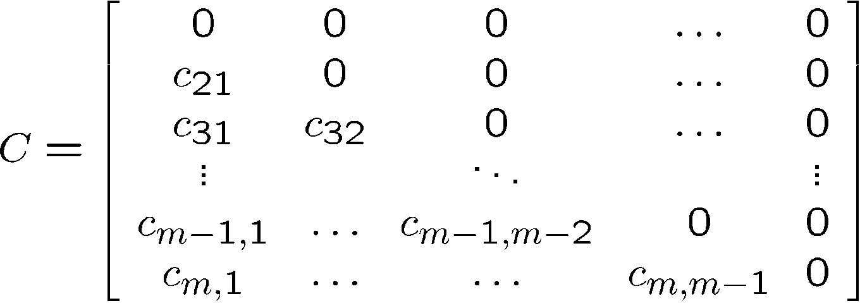
Other PCA Neural Networks
APEX Model: Kung and Diamantaras
y = Wx – Cy , y = (I+C)⁻¹Wx ¼ (I-C)Wx
x₁
y₁
x₂
c₂
x₃
y₂
c_{m}
y_{m}
x_{n}

Slide 17
Other PCA Neural Networks
Multi-layer networks: bottlenecks
Train using auto-associative output.
e = x – y
W_{L} spans the subspace of the first m principal eigenvectors.
x₁
W_{L}
W_{R}
y₁
x₂
y₂
x₃
y₃
x_{n}
y_{n}

Slide 18
More on Autoencoder
The network tries to reproduce the input in the output, inducing an short encoding in the hidden layer.
This encoding retains the maximum amount of information about the input in a smaller dimensional space such that the input can be reconstructed.
Auto-encoder can implement PCA subspace, which is trained with backprop and consisted of exclusively linear units.

Slide 19
More on Auto-encoder Networks
It turns out that the M hidden units extract the first M principal components.
Autoencoder networks can be used for dimensionality reduction, compression, etc.
Because all units are linear, there is a single global minimum.
Deep auto-encoder
stacked (denoising) autoencoder
http://deeplearning.net/tutorial/SdA.html

